Slide 1
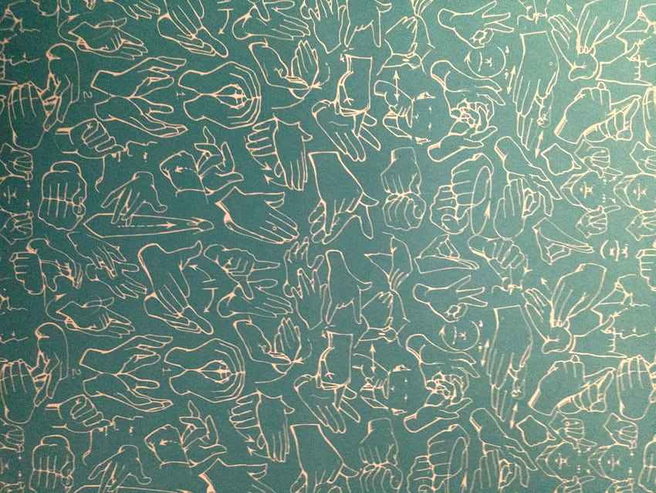
College of Technology, GBPUA&T, Pantnagar
Department of Computer Engineering
Course : Project (TCT-495)
ACADEMIC PROJECT PRESENTATION
Topic: Conversion of Sign Language to Speech for Teaching Support to Empowering Deaf & Dumb
GROUP 1 MEMBERS
1. Ayush Pratap Singh (56068)
2. Ansh Kumar (56094)
3. Shivanshu Rawat (56930)
Course I/C : Dr P.K. Mishra
Project Guide : Dr S.D. Samantaray

Slide 2
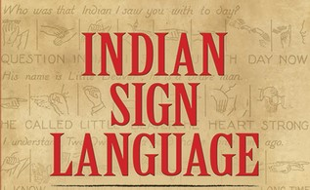
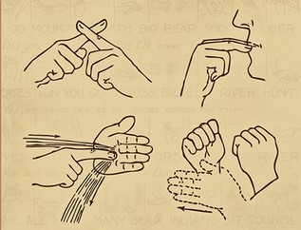
Conversion of Sign Language to Speech
For Deaf and Dumb

Slide 3

Abstract
Our project aims to create a computer application and train a model which when shown a real time video of hand gestures of Indian Sign Language converts the output for that particular sign in voice format.

Slide 4
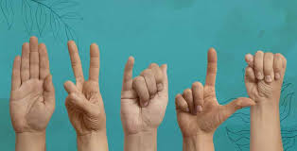
Introduction to Sign Language

Slide 5
What is Sign Language?
Sign language is a visual means of communicating using gestures, facial expressions, and body language. It is the primary language for many Deaf and hard-of-hearing individuals.
Importance of Sign Language
Enhances Communication
Promotes Inclusivity
Bridges Communication Gaps

Slide 6
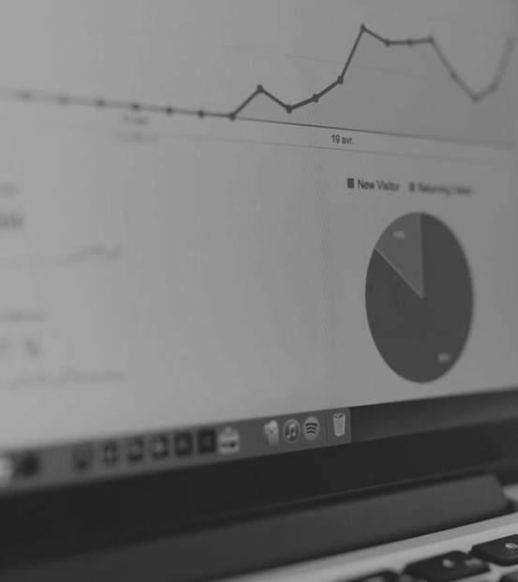
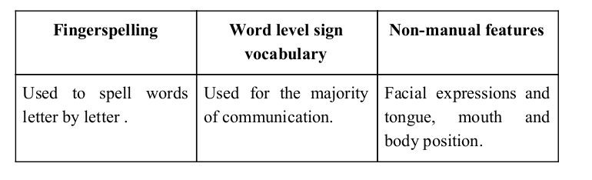
Sign language is a visual language and consists of 3 major components:

Slide 7
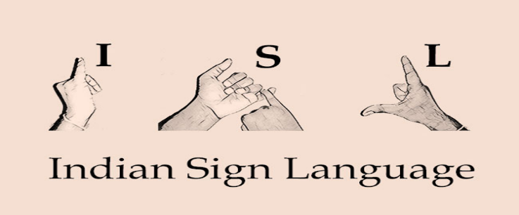
Overview of Indian Sign Language (ISL)
History: Indian Sign Language has been used for centuries, with formal documentation and standardization efforts beginning in the 20th century.
Recognition: In 2001, the Indian government began recognizing ISL as a legitimate language, leading to increased support and resources.
Dominance: As of 2024, it is the most used sign language in the world, being used by more than 15 million people.
Alphabet: ISL uses a manual alphabet where each letter of the English alphabet is represented by a unique hand sign.
Numbers: ISL has specific signs for numbers 0-9 and combinations for larger numbers.

Slide 8
Some facts about sign language
Diversity: There are many different sign languages globally, each with unique signs and grammar, such as American Sign Language (ASL), British Sign Language (BSL), and Indian Sign Language (ISL).
Recognition and Rights: Many countries now officially recognize sign languages and have policies to support their use in education and public life. For example: ASL and BSL are recognized in their respective countries.
ISLRTC: The Indian Sign Language Research and Training Centre (ISLRTC) was established to promote the development and standardization of ISL.
Media and Technology: ISL is being promoted through various media, including television programs with sign language interpretation, and digital platforms offering ISL resources. More recently in the T20 World Cup 2024, you can watch the matches in ISL also.

Slide 9
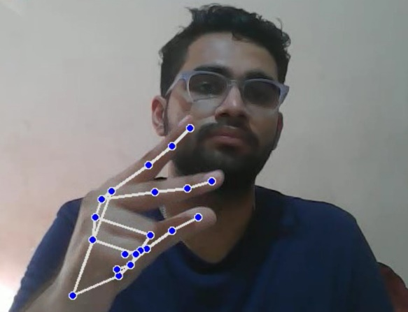
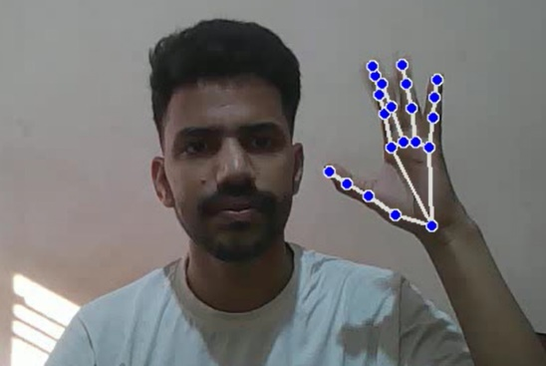
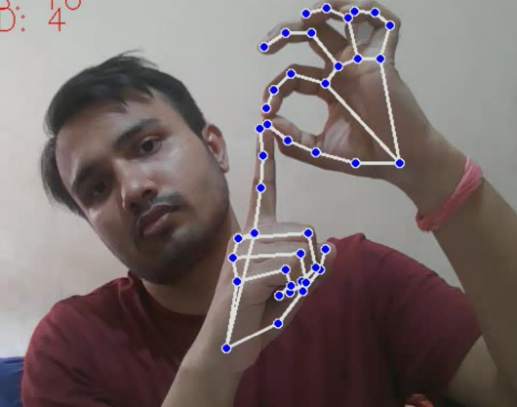
We have implemented in total 62 signs representing Indian states and their capitals of ISL in our project.

Slide 10
Methodology / Implementation

Slide 11
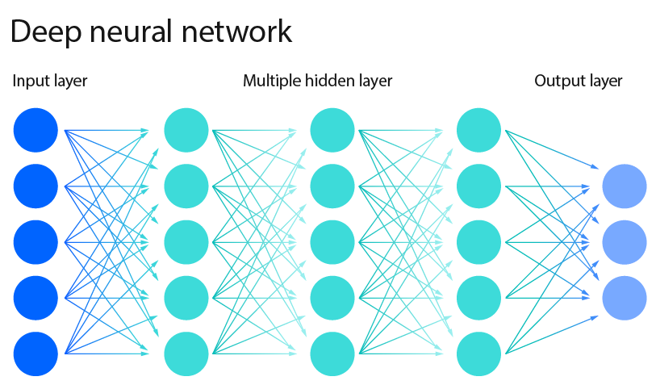
Solution Overview
LSTM based Neural Network model
Model understand Sign Language
Converts Sign language to Text
Text To Audio using TTS module
Model Can be trained on any language dataset: ISL, BSL, ASL, etc.…

Slide 12

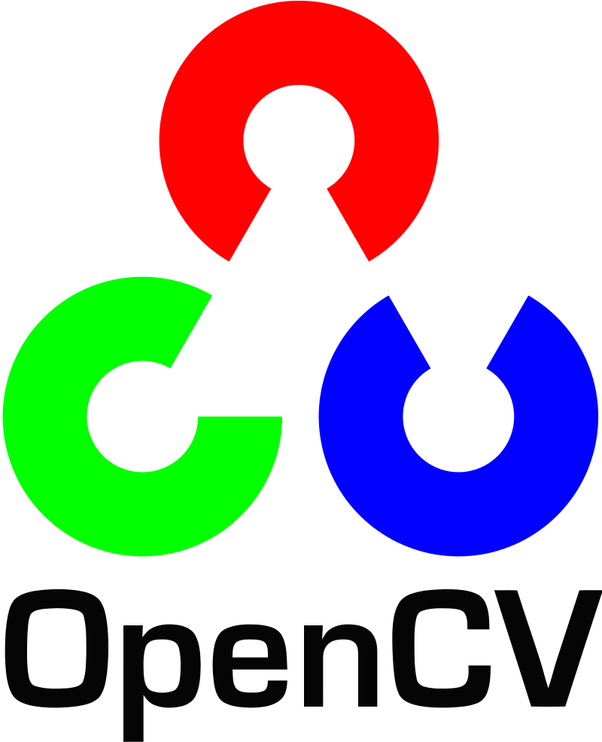



Requirements
Software Requirements:
Python : For Developing Solution
Packages/ Libs:
Mediapipe : For Hand-Keypoint/ Landmark detection
Keras : For Compiling LSTM based Neural Network
OpenCV : For Image Processing.
Numpy : For performing ARRAY operations
Hardware Requirements:
CPU: Intel core i3 or greater / Apple silicon chip >=M1
Memory : >= 8GB
Camera or webcam

Slide 13

Design
FRAMES
FRAMES
LSTM + Fully Connected NN
FRAMES
Hand Landmark Extraction
TTS module
Sign in Text Form

Slide 14
Implementation
For implementing various subtasks, we have created following files:
data_collection.py
training.py
inference.py
Data Collection
Inferring
Training

Slide 15
How we generated data set and did Data Preprocessing ?

Slide 16
First Approach
In this approach for hand detection, firstly we detected hand from image that is acquired by webcam and for detecting a hand we used media pipe library which is used for image processing.
So, after finding the hand from image we get the region of interest (RoI) then we cropped that image and converted the image to gray image using OpenCV library and thereafter we applied the gaussian blur. The filter can be easily applied using OpenCV library.
Then we converted the gray image to binary image using threshold and Adaptive threshold methods.

Slide 17
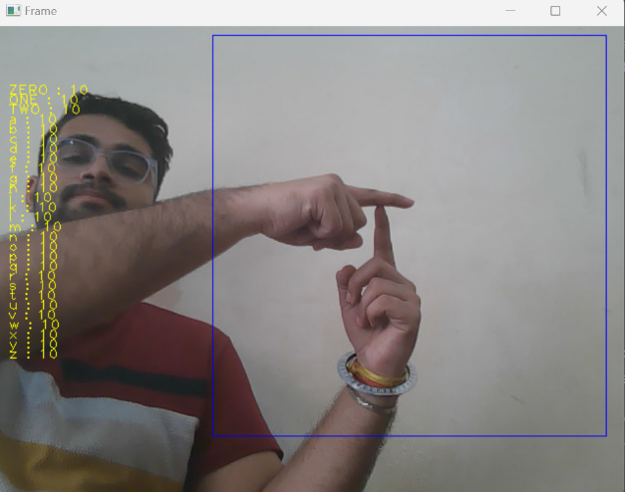
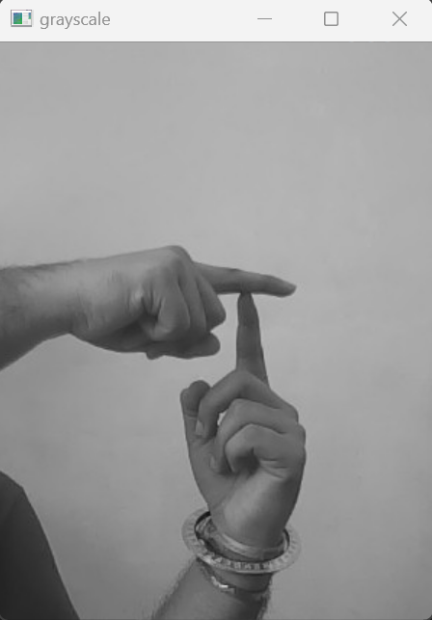
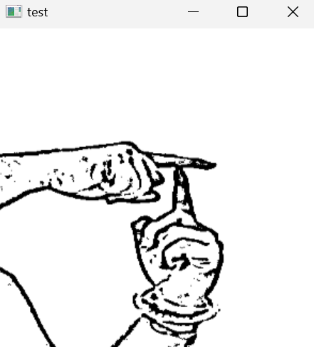
Image Post Gaussian Blur
Capturing Raw Image
Gray Scale Image

Slide 18
Loopholes in the previous method and its correction
In the previous method there are many loop holes like:
hand must be ahead of clean soft background
proper lightning condition
varied hand colours, etc.
then only this method will give good accurate results but in real world we don't get good background everywhere and we don’t get good lightning conditions too.
So to overcome this situation we tried different approaches then we reached at one interesting solution in which firstly we detect hand from frame using mediapipe and get the hand landmarks of hand present in that image and store those hand landmarks in a numpy array.

Slide 19
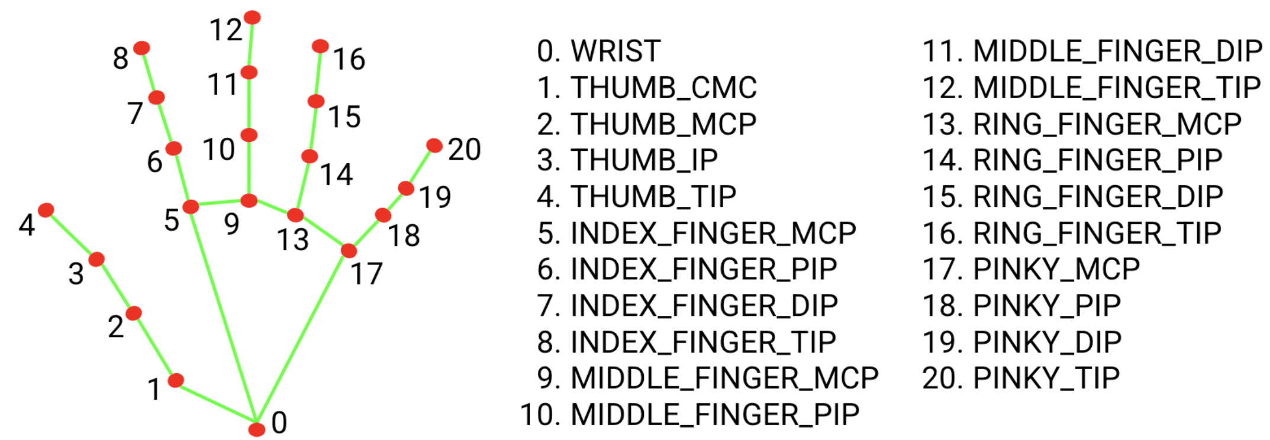
Mediapipe Handtracking module

Slide 20
Why we Created our own Dataset ?

Slide 21
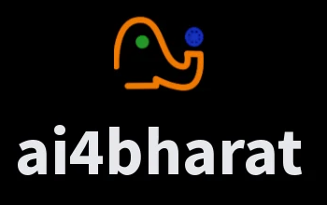
For the project we tried to find already made datasets but we couldn’t find dataset in the form of raw images that matched our requirements.
All we could find were the datasets in the form of poor quality videos.
Hence we decided to create our own data set.
We have followed the repository of Indian Sign Language created under the ai4bharat project at IIT Madras.
The dictionary for the same can be found at below link:
https://sign-language.ai4bharat.org/#/dictionary

Slide 22
Using LSTM for Sign Language Detection

Slide 23
What is an LSTM?
Long Short-Term Memory (LSTM) networks are a type of recurrent neural network (RNN) particularly effective for sequence prediction problems.
LSTM create both short-term and long-term memory components to efficiently study and learn sequential data.
This makes LSTMs ideal for applications like sign language detection, where the sequence of movements and gestures matters.
Key Concepts of LSTM
Sequences: Unlike regular neural networks that handle one input at a time, LSTMs work with sequences of data (e.g., video frames, sentences).
Memory: LSTMs have a memory cell that can store information for long periods. This helps them remember what happened in previous steps of the sequence.
Gates: LSTMs use gates to control the flow of information into and out of the memory cell. There are three types of gates:
Forget Gate: Decides what information to discard from the memory.
Input Gate: Decides what new information to add to the memory.
Output Gate: Decides what information to output from the memory.

Slide 24
Why LSTM for Sign language detection?
Firstly we tried using Convolutional Neural Networks (CNNs).
CNNs are very effective at processing and extracting features from spatial data, such as images and video frames. They excel at identifying patterns like edges, textures, and shapes within an image.
But while researching upon various signs, we saw that most of the signs for words like “India”, “Hello”, etc. contained hand motions.
CNN lacks the ability to remember previous frames, making it unsuitable for capturing the flow of gestures.
Whereas, LSTM is specifically designed to handle sequential data, capturing temporal dependencies across frames.
LSTM maintains context over time, crucial for understanding the continuous movement in sign language.
It can understand the dynamics and timing of gestures, essential for distinguishing between different signs.

Slide 25
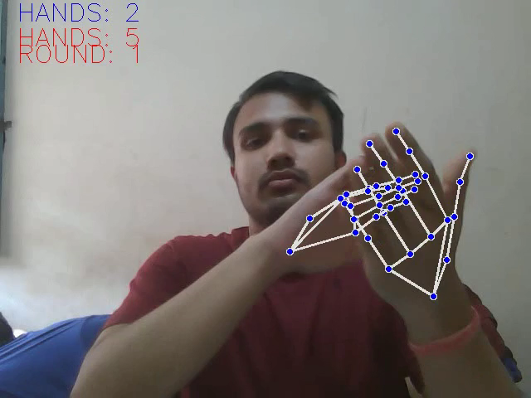
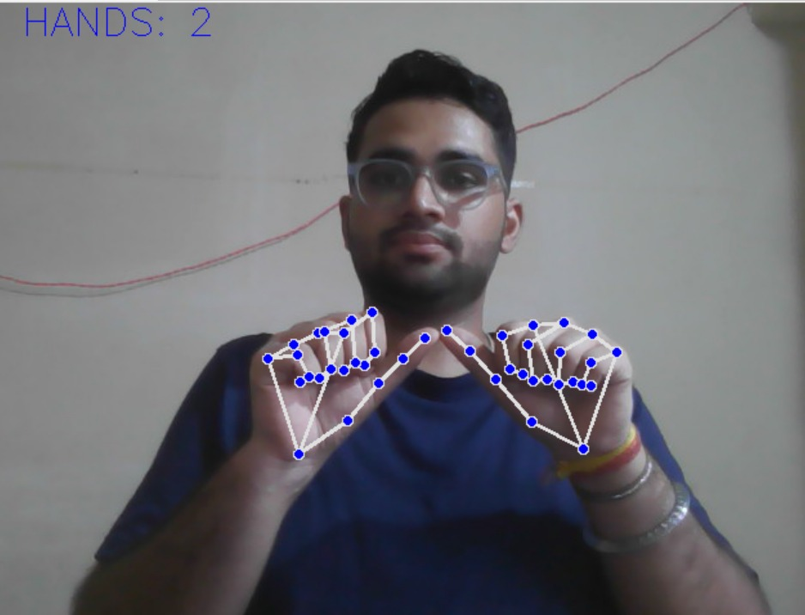


Indian Sign Language for the state of “HARYANA”
Involves Hand Motion
LSTM
CNN
Indian Sign Language for the alphabet “A”
Does NOT involve Hand Motion
LSTM
CNN

Slide 26
LSTM Model for Sign Language Detection
The 3 basic steps involved in detecting sign language from real-time video are as follows:
Frame Processing: Each video frame is processed to extract features.
Sequence Handling: LSTM takes the sequence of these features over time.
Context Understanding: LSTM uses its memory to understand the flow of gestures, maintaining context from previous frames to correctly identify signs.

Slide 27
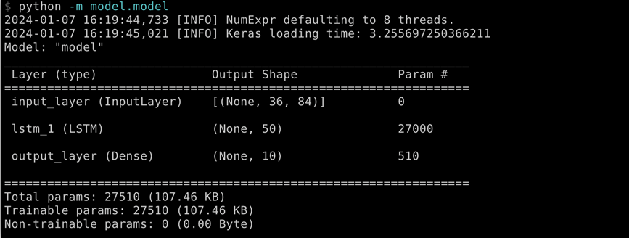
Training
Data loaded which was stored in data preprocessing part
LSTM based Model compiled via KERAS api
.train() function called on model
Our model is trained for 50 epochs

Slide 28
Inference
Also called Prediction part
Model loaded saved previously
Video Capture starts
Frame Preprocessing done
Prediction called
Text to Speech module called

Slide 29
Challenges Faced
We couldn’t find a dataset with raw images of all the required characters so we made our own dataset.
Some signs involved long sequences of movements, and capturing long-term dependencies accurately was challenging.
Issues were faced relating to the accuracy of the model we trained in earlier phases which we eventually improved by improving the dataset.

Slide 30
Limitations of our model
The model works well only in good lighting conditions.
Plain background is needed for the model to detect with accuracy.

Slide 31
Conclusion
The project demonstrates the potential and effectiveness of Long Short-Term Memory (LSTM) networks in addressing the complex task of sign language recognition from real-time video data.
By leveraging the unique capabilities of LSTMs to handle sequential data and capture long-term dependencies, we have made significant strides towards creating a robust system that can interpret sign language accurately and efficiently.
LSTM networks have shown their strength in capturing the intricate temporal dependencies inherent in sign language, ensuring that the context and flow of gestures are accurately interpreted.
We achieved an accuracy of 97.8% on our dataset.

Slide 32
Future Scope
Expanded Datasets: We are thinking of increasing the size and diversity of training datasets. It will enhance the model's ability to generalize across different signers and environments.
We are also thinking of improving the pre-processing to predict gestures in low light conditions with a higher accuracy.
Multimodal Integration: We are thinking of combining sign language recognition with other modalities, such as facial expression and body posture analysis. It can provide a more comprehensive understanding of sign language.
Developing mobile application: We are also thinking of developing user-friendly interfaces and applications that integrate this technology and can significantly impact the daily lives of the deaf and hard-of-hearing community

Slide 33
